Slide 1
FLIGHT PRICE PREDICTION PROJECT
BY SANJAY SIVAKUMAR

Slide 2
BACKGROUND OF THIS PROJECT
Optimal timing for airline ticket purchasing from the consumer’s perspective is challenging principally because buyers have insufficient information for reasoning about future price movements. In this project we majorly targeted to uncover underlying trends of flight prices in India using historical data and also to suggest the best time to buy a flight ticket.
Anyone who has booked a flight ticket knows how unexpectedly the prices vary. The cheapest available ticket on a given flight gets more and less expensive over time. This usually happens as an attempt to maximize revenue based on –
1. Time of purchase patterns (making sure last-minute purchases are expensive)
2. Keeping the flight as full as they want it (raising prices on a flight which is filling up in order to reduce sales and hold back inventory for those expensive last-minute expensive purchases)

Slide 3
PROBLEM FRAMING
The objectives of the project can broadly be laid down by the following questions –
1.Flight Trends Do airfares change frequently? Do they move in small increments or in large jumps? Do they tend to go up or down over time?
2. Best Time To Buy What is the best time to buy so that the consumer can save the most by taking the least risk? So should a passenger wait to buy his ticket, or should he buy as early as possible?
3. Verifying Myths Does price increase as we get near to departure date? Is Indigo cheaper than Jet Airways? Are morning flights expensive?

Slide 4
HARDWARE AND SOFTWARE REQUIREMENTS
Programming language – python 3.0
Libraries and Packages
1.pandas- for dataframing the dataset
2.numpy- for any analytical functions
3.seaborn and matplotlib-for visualization process
4.train_test_split- for splitting data into training and testing
5.And I have imported regression algorithms such as Random Forest Regressor,KNeighbors Regressor etc… for model building.
6.And finally imported metrics for regression problem for proper model selection.

Slide 5
TECHNIQUES AND METHODS USED
1.Z-Score method -> for removing skewness/outliers
2.Box-Cox transformation -> for removing skewness/outliers
3.Correlation method -> for analyzing the correlation of input columns with our target column
4.VIF method-> to check for any multicollinearity present in our input columns
5.Standard Scaler method- >to standardize our input column data.

Slide 6
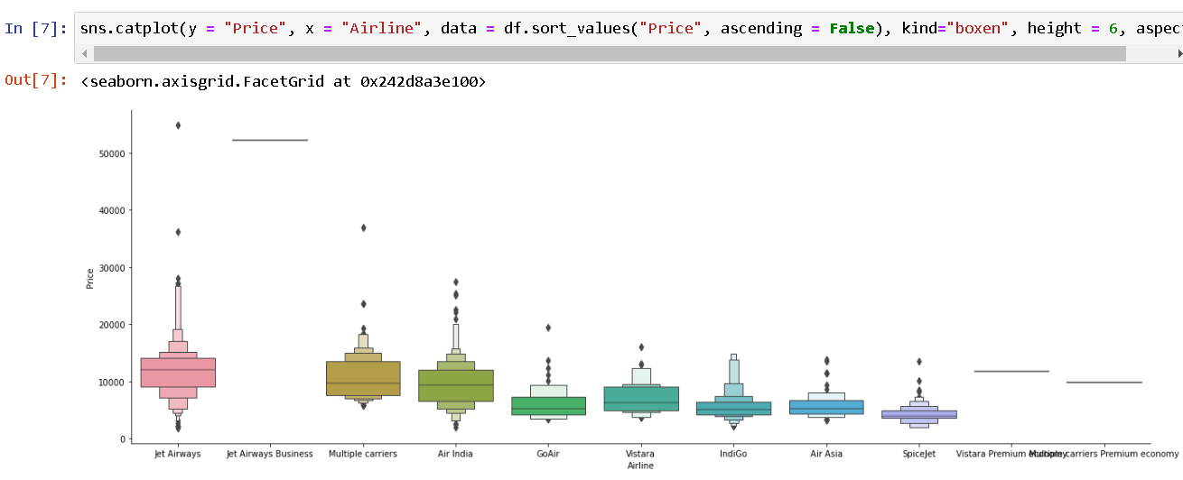

Slide 7
ALGORITHMS USED FOR MODEL BUILDING
1.Linear Regression
2.Decision Tree Regressor
3.Random Forest Regressor
4.KNeighbors Regressor

Slide 8
KEY METRICS USED
1. r2 score-> to know the accuracy of the model
2. Mean squared error-> provides us the error present in the model

Slide 9
FINAL MODEL-RANDOM FOREST REGRESSOR
IT HAS LESS DIFFERENCE BETWEEN THE TESTING AND TRANING SCORE
IT HAS LESS DIFFERENCE BETWEEN ACTUAL ACCURACY AND CROSS-VALIDATION MEAN SCORE

Slide 10
CONCLUSION
After my final model I got a accuracy which is not that great in this scenario and this accuracy can be further increased by adding more columns and using advanced feature Engineering to this dataset.

